Slide 1
ScrypTrac
Taking the danger out of proper prescription drug use

Slide 2
Our Team
Brian Anderson
Software Developer, Founder
Jay Looney
Software Developer
Connie Zurski, APN, CNS (remote)
Physician’s Assistant

Slide 3
Problem Space
Millions of dollars and thousands of lives are lost each year from prescription medications.
Taking properly prescribed drugs is the fourth leading cause of death in the U.S.
Adverse drug reactions are estimated to result in approximately 1.5 to 2.7 million hospitalizations each year.
This is the Cost of Poor Quality in the Prescription Drug Marketplace
*https://health.usnews.com/health-news/patient-advice/articles/2016-09-27/the-danger-in-taking-prescribed-medications

Slide 4
Potential Failure Modes
Contraindicated Drug
Incomplete Order
Allergy
Transcribing Error
Wrong Dose / Frequency
Wrong Drug
Polyprovider
https://www.slideshare.net/samthamby79/prescription-53358524
Illegible Order
Omission
Altered Order
Wrong Patient
Wrong Route
Polypharmacy

Slide 5
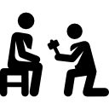

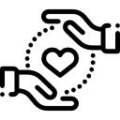
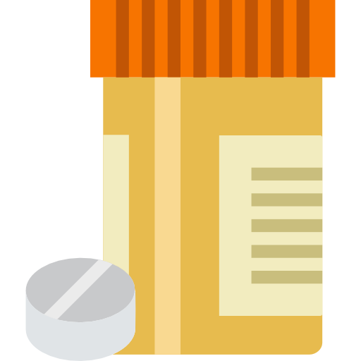
ScrypTrac Problem Space
Patient²
Physician¹
Brian Anderson
Software Developer, Founder
Jay Looney
Software Developer
Connie Zurski, APN, CNS (remote)
Physician’s Assistant
Rx
Payer²
Pharmacist¹
¹Designed by Smashicons from Flaticon
²Designed by Freepik from Flaticon

Slide 6
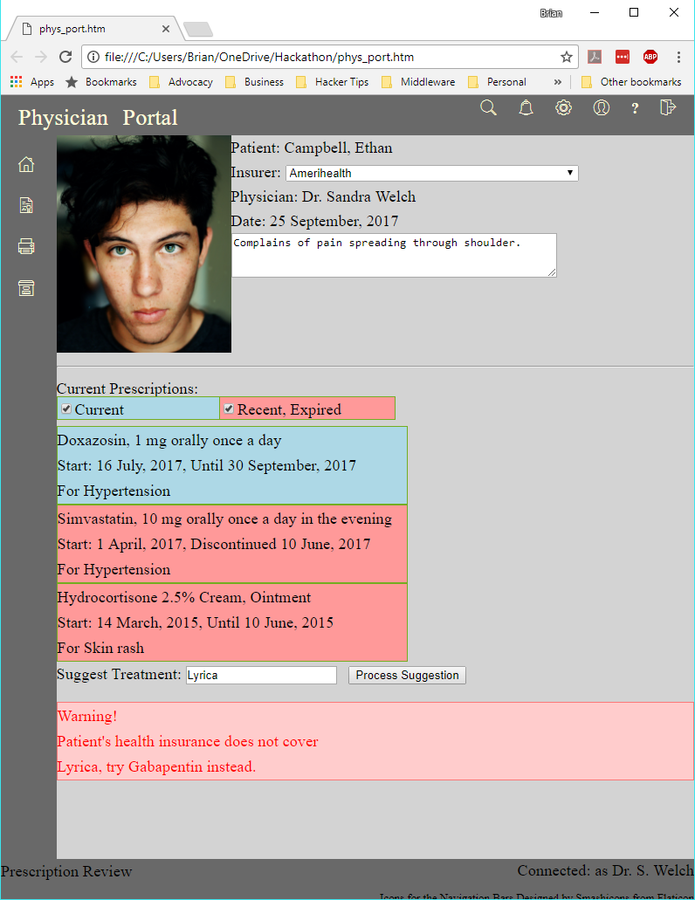
Physician Portal
Blockchain will be used to track:
prescription creation
transcription
drug substitution
interaction and overmedication
patient instruction
order completeness and transmission

Slide 7
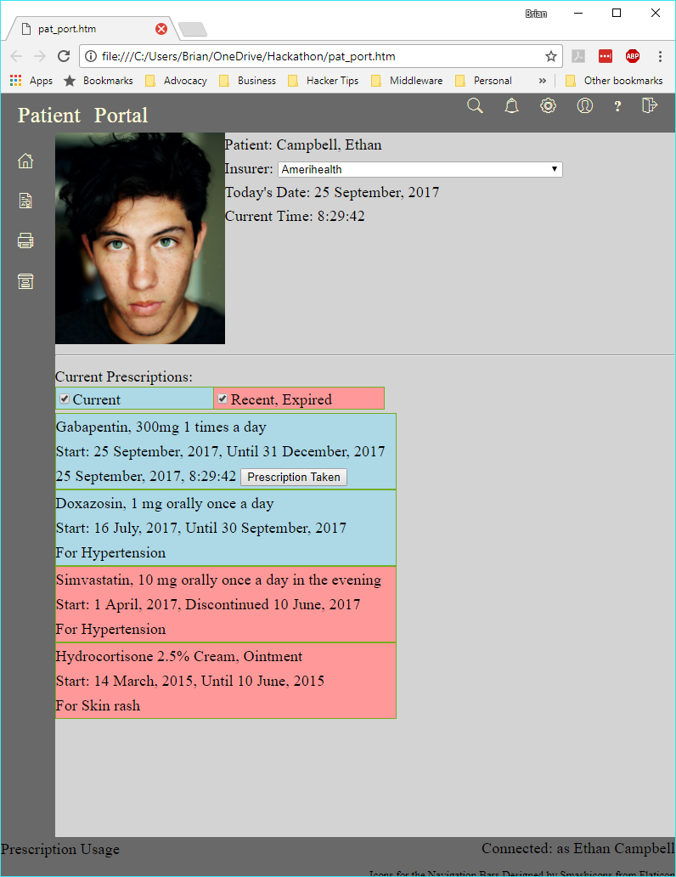
Patient Portal
Blockchain will be used to track:
prescription usage
data sharing w/ other stakeholders
activity and exercise
interaction and overmedication
patient instruction
reaction and side effect

Slide 8
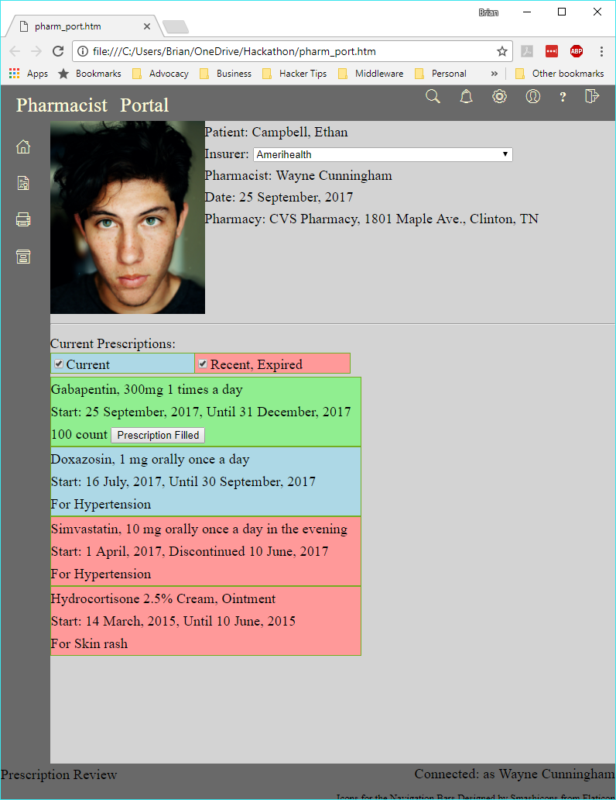
Pharmacist Portal
Blockchain will be used to track:
prescription dosage
modification and collaboration
interaction and overmedication
patient instruction
delivery packaging

